Slide 1
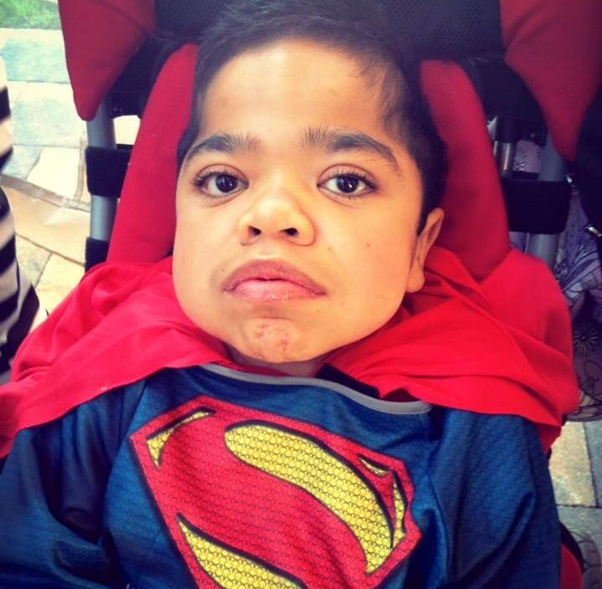
Adan’s Journey
Adans’s Story

Slide 2
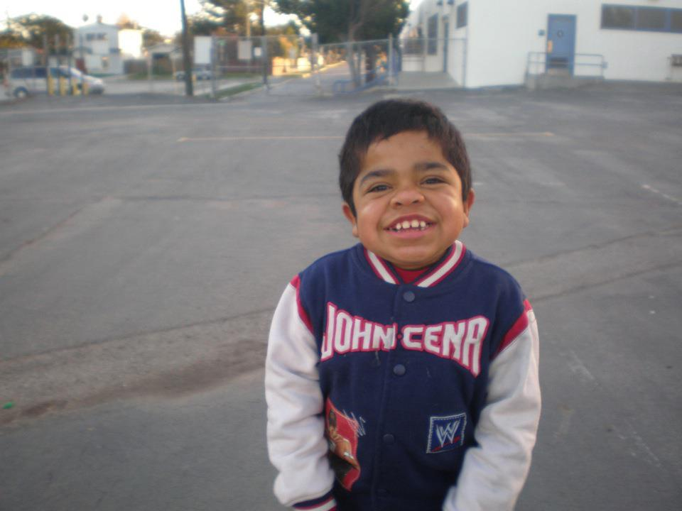
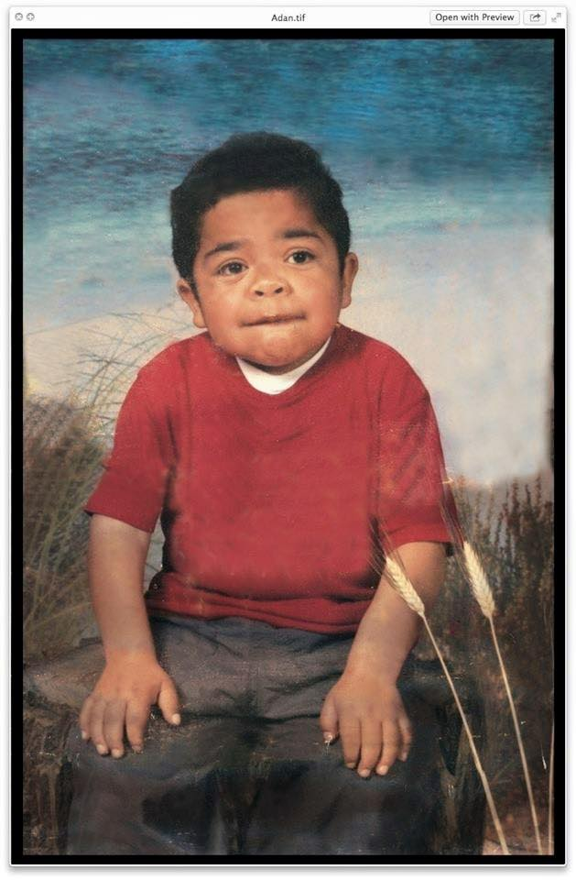
Adans Story
On November 5, 1997 Adan was happily welcomed by his family of six, his two parents and four siblings.
Growing up Adan was a very sweet, happy child, very playful and at times quite mischievous.

Slide 3
The Diagnosis
During his early development, Adan’s parents began noticing slight developmental delays which prompted genetic testing to determine if anything was wrong.
At the age of 3, after many tests and visits with doctors, Adan was diagnosed with a rare, life limiting disease called MPS II, also known as Hunters Syndrome.
Hunter syndrome is a rare genetic disorder that occurs when an enzyme your body needs is either missing or doesn’t work properly. Because the body doesn’t have enough of the enzyme to break down certain complex molecules, the molecules build up in harmful amounts in certain cells and tissues. The buildup that occurs in Hunter syndrome eventually causes permanent, progressive damage affecting appearance, mental development, organ function and physical abilities. Hunter syndrome appears in children as young as 18 months. It nearly always occurs in males. There’s no cure for Hunter syndrome. Treatment of Hunter syndrome involves management of symptoms and complications.

Slide 4
Complications Of MPS II
Complications Include:
A variety of complications can occur with Hunter syndrome depending on the type and severity of the disease. Complications can affect the lungs, heart, joints, connective tissue, and brain and nervous system.
Respiratory complications
An enlarged tongue, thickened gums, and thickening of the nasal passages and windpipe (trachea) make breathing difficult. Children often have chronic ear and sinus infections, respiratory infections, and pneumonia.
Sleep apnea, a condition in which breathing is intermittently interrupted during sleep, is often present because of airway constriction.
Cardiac complications
Thickening of heart tissue can cause improper closing of heart valves. As a result, the heart and other parts of the body don't receive blood efficiently. As the disease progresses, these conditions often become worse and typically result in heart failure.
The thickening of tissue can also cause narrowing of the aorta (coarctation) and other blood vessels. This in turn can result in high blood pressure (hypertension) and narrowing of arteries in the lungs (pulmonary hypertension).
Skeletal and connective tissue complications
The storage of undigested complex sugar molecules in connective tissues results in abnormalities in bones, joints and ligaments. This reduces your child's growth, causing pain and physical malformations and making it difficult for him or her to move.
Joint stiffness is caused by swelling of joint connective tissues and abnormalities of cartilage and bones. If your child is in pain, he or she will likely move less, which can lead to more stiffness and pain.
The group of abnormalities typically seen in the bones of people with Hunter syndrome is called dysostosis multiplex. Children with these abnormalities can develop irregularly shaped vertebrae and spines (kyphoscoliosis), ribs, arms, fingers, legs, and pelvises.

Slide 5
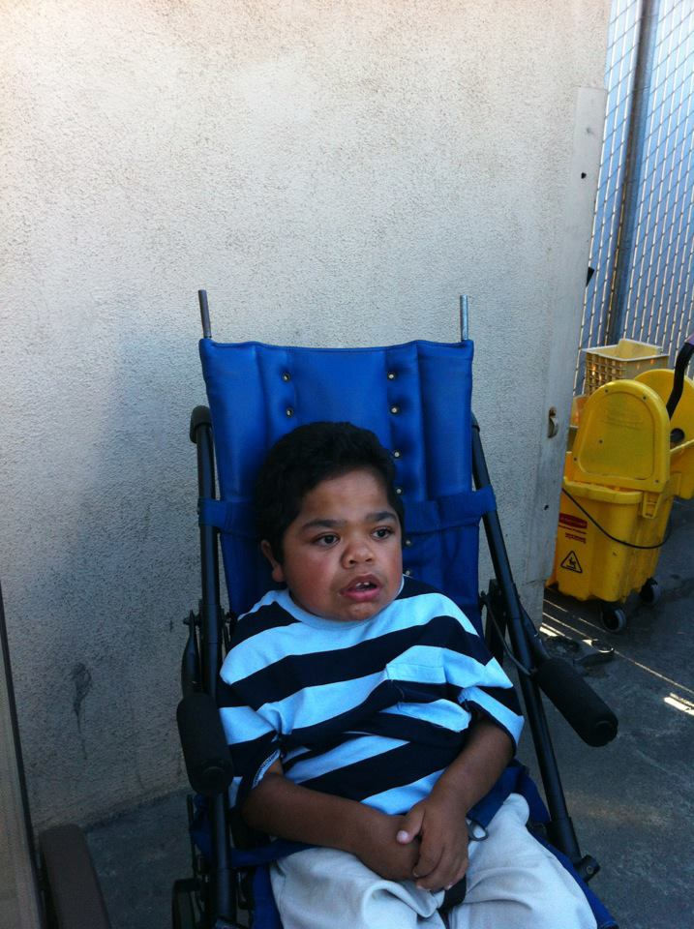
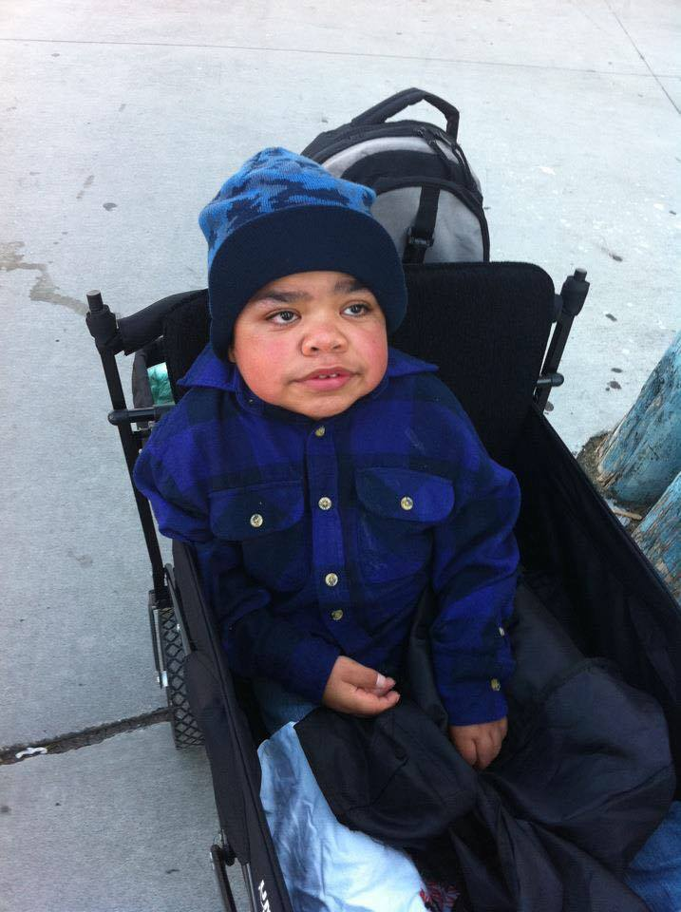
Down Spiral in Health
Overall, Adan’s health was good. No major complications related to his syndrome.
On the evening of September 5, 2010 Adan suffered his first major seizure which resulted in him loosing his ability to walk.

Slide 6
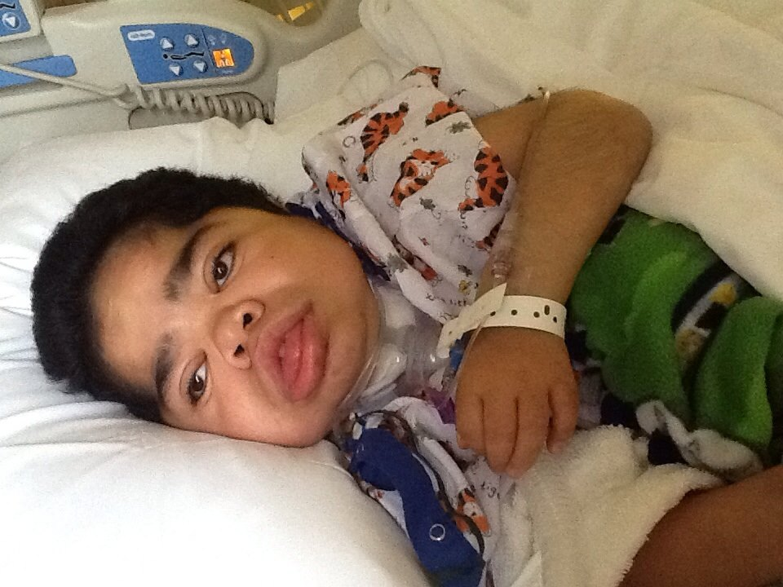
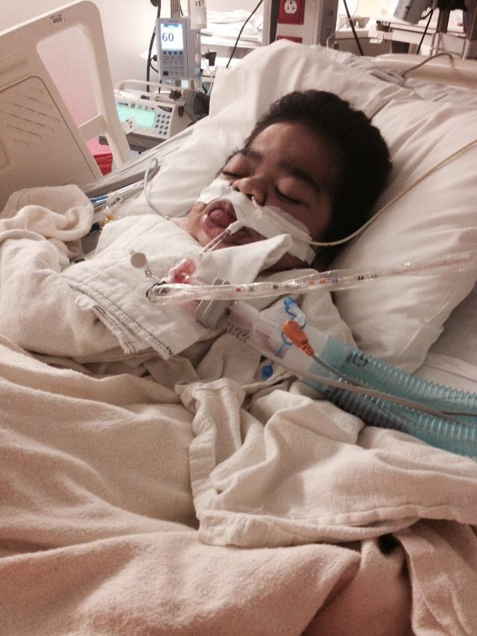
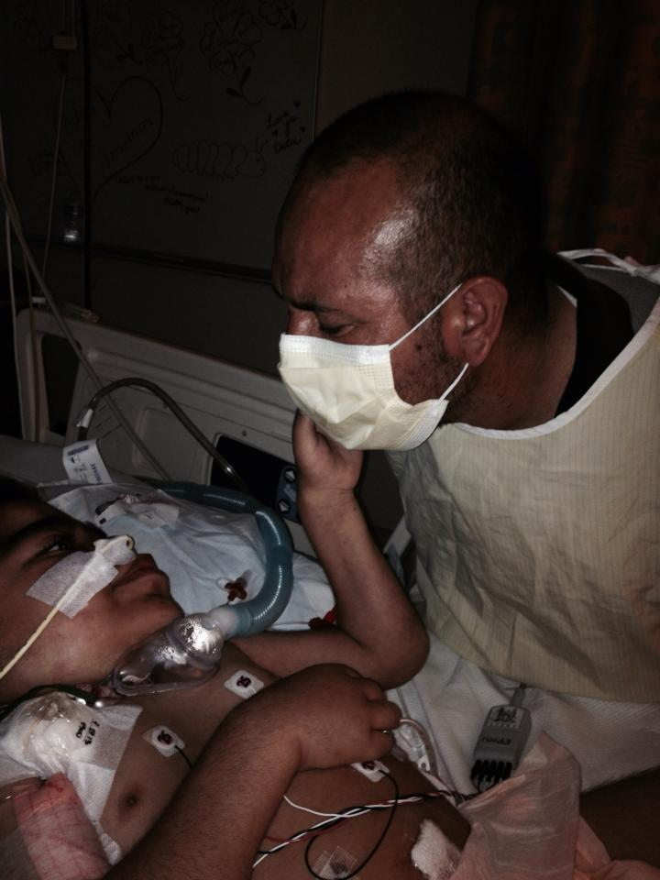
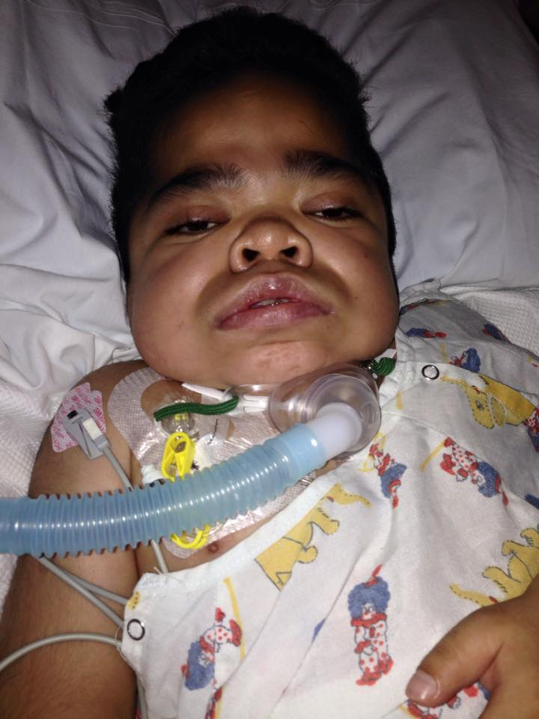
Major Surgery & Hospitalization
Seizures became more & more common in the following years after September 2010. Adan was prescribed anti-seizure medications. His condition did not seem to deteriorate any further as all his semi annual tests showed no changes.
On April 21, 2014, during a visit to the hospital, without warning Adan stopped breathing. Emergency intubation was performed.

Slide 7
Adan remained sedated for the next few days, prepping for his major Trache and G Tube surgery on April 25. 2014.
Following the surgery, Adan’s condition deteriorated fast. He was in and out of hospital every other week due to issues with pain management and feeding. Doctors advised the family to prepare for the inevitable and even offered hospice options.
Adan’s mother refused to accept this. In the fall of 2014, given the dire situation Adan was in his mother decided to start a cannabis regimen in hopes to alleviate some of his pain which was no longer manageable with Morphine and Fentanyl.

Slide 8
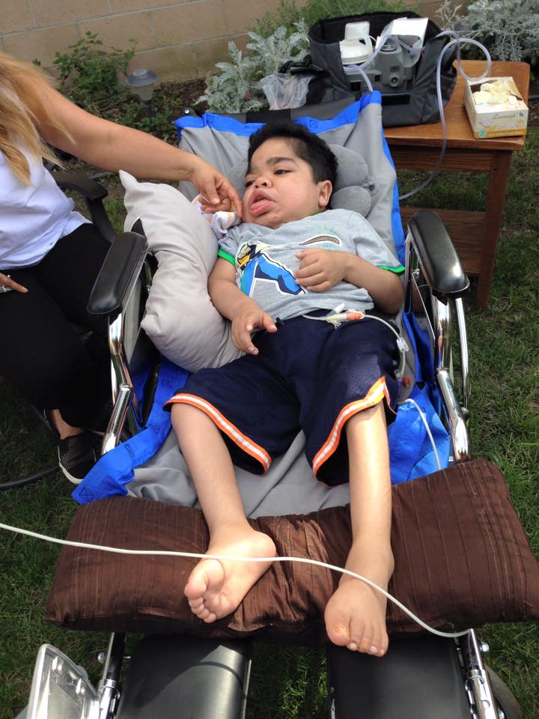
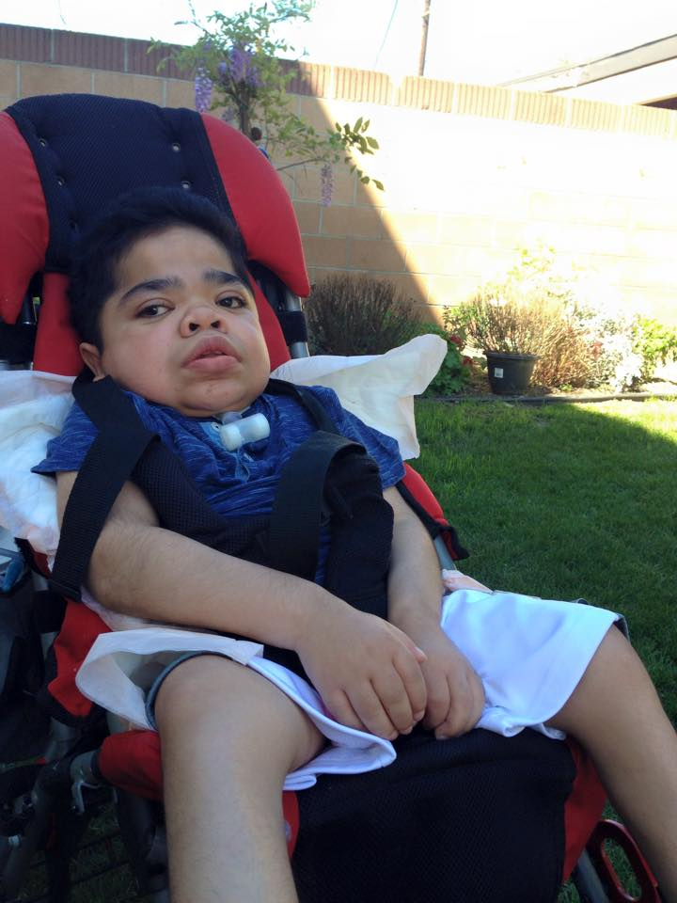
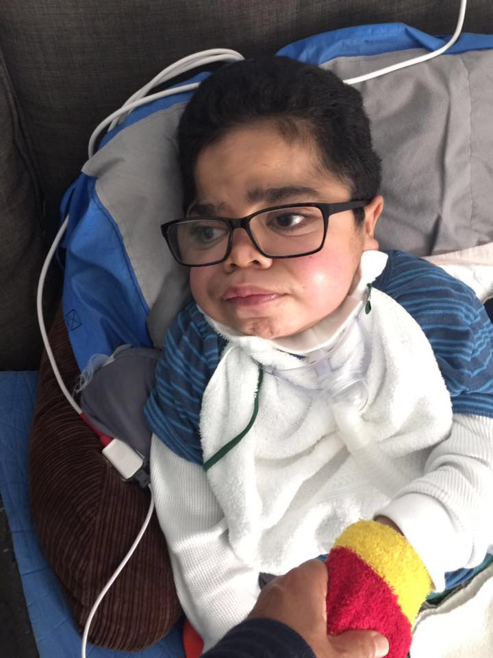
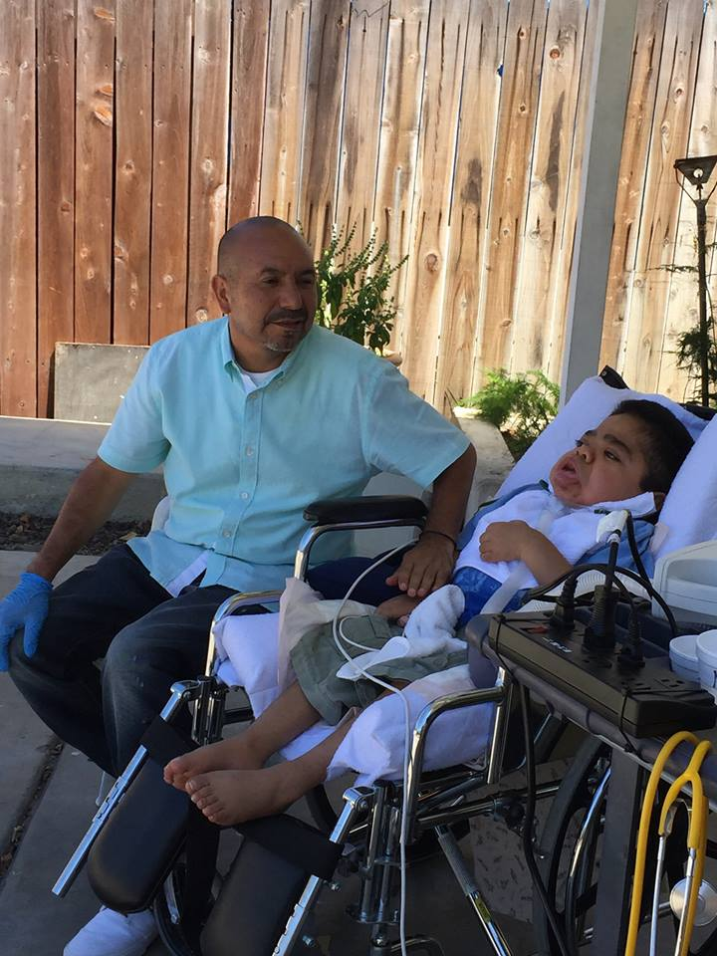
Cannibis Regimen
The effects were immediate. Adan’s pain became manageable!

Slide 9
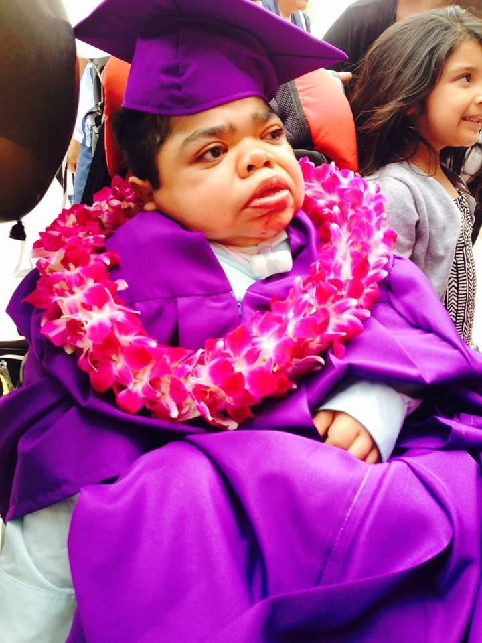
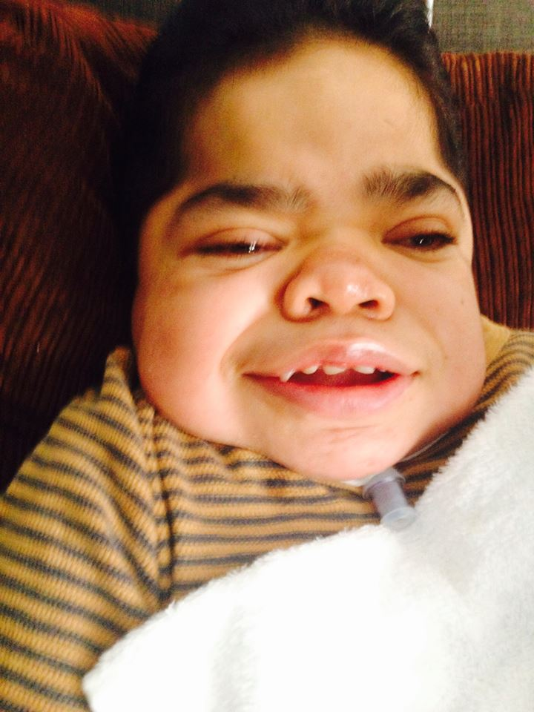
Against all odds and Doctor predictions, Adan overcame all medical obstacles. He continues his daily regimen of cannabis. His condition has not only ceased to progress, but it has left doctors baffled as they have seen not only physical improvement but also neurological improvements too.

